Slide 1


Design of Compilers

Slide 2

StudentID | Name
21P0186 | Saifeldin Mohamed Hatem
22P0122 | Basel Ashraf Fikry
2001038 | Mohamed Ahmed Abdelraouf
2000052 | Ahmed Mohamed Abdelmonem
21P0285 | Abdalrahman Khaled Alkawwa
Submitted to :
Dr.Wafaa Al Kasas
Eng.Ahmed Salama

Slide 3

Token Definitions

Slide 4

Token Definitions
NUMBER - Matches various forms of numbers, including integers and floats
COMPARISON_OP - Identifies comparison operators
COMPOUND_OP - Matches compound assignment operators
ASSIGNMENT_OP - Recognizes assignment operator
TERNARY_OP - Matches the ternary operator
COLON - Identifies colon punctuation
SHIFT_OP - Matches shift operators
UNARY_OP - Identifies unary operators

Slide 5

Token Definitions
ARITHMETIC_OP - Recognizes arithmetic operators
BITWISE_OP - Identifies bitwise operators
LEFT_PAREN - Recognizes left parenthesis
RIGHT_PAREN - Matches right parenthesis
LEFT_BRACKET - Identifies left square bracket
RIGHT_BRACKET - Matches right square bracket
LEFT_BRACE - Recognizes left curly brace
RIGHT_BRACE - Matches right curly brace

Slide 6

SEMICOLON - Identifies semicolon punctuation
COMMA - Matches comma punctuation
DOT - Identifies dot punctuation
TYPE_SPECIFIER - Recognizes C type specifiers
KEYWORD - Matches C keywords
STRING_LITERAL - Identifies string literals
CHARACTER_LITERAL - Matches character literals
ID - Recognizes identifiers
PUNCTUATION - Matches various punctuation marks

Slide 7

Lexical Implementation

Slide 8
Lexical Implementation
Tokenization process overview
Token Enumeration and Definition
Token Class structure
Tokenization Process steps
Handling Comments and Whitespace
Iterative Tokenization for accuracy
Error Handling mechanisms
File Input and Output functionalities

Slide 9

Symbol Table Implementation
The symbol table is generated during lexical analysis to keep track of identifiers encountered in the code
The symbol table is implemented as an ArrayList of Tokens, where each Token represents an identifier
The symbol table is printed after lexical analysis is complete

Slide 10

Parser and Grammar Rules Overview
Detailed explanation of the grammar rules for the compiler
List each grammar rule with its corresponding definition

Slide 11
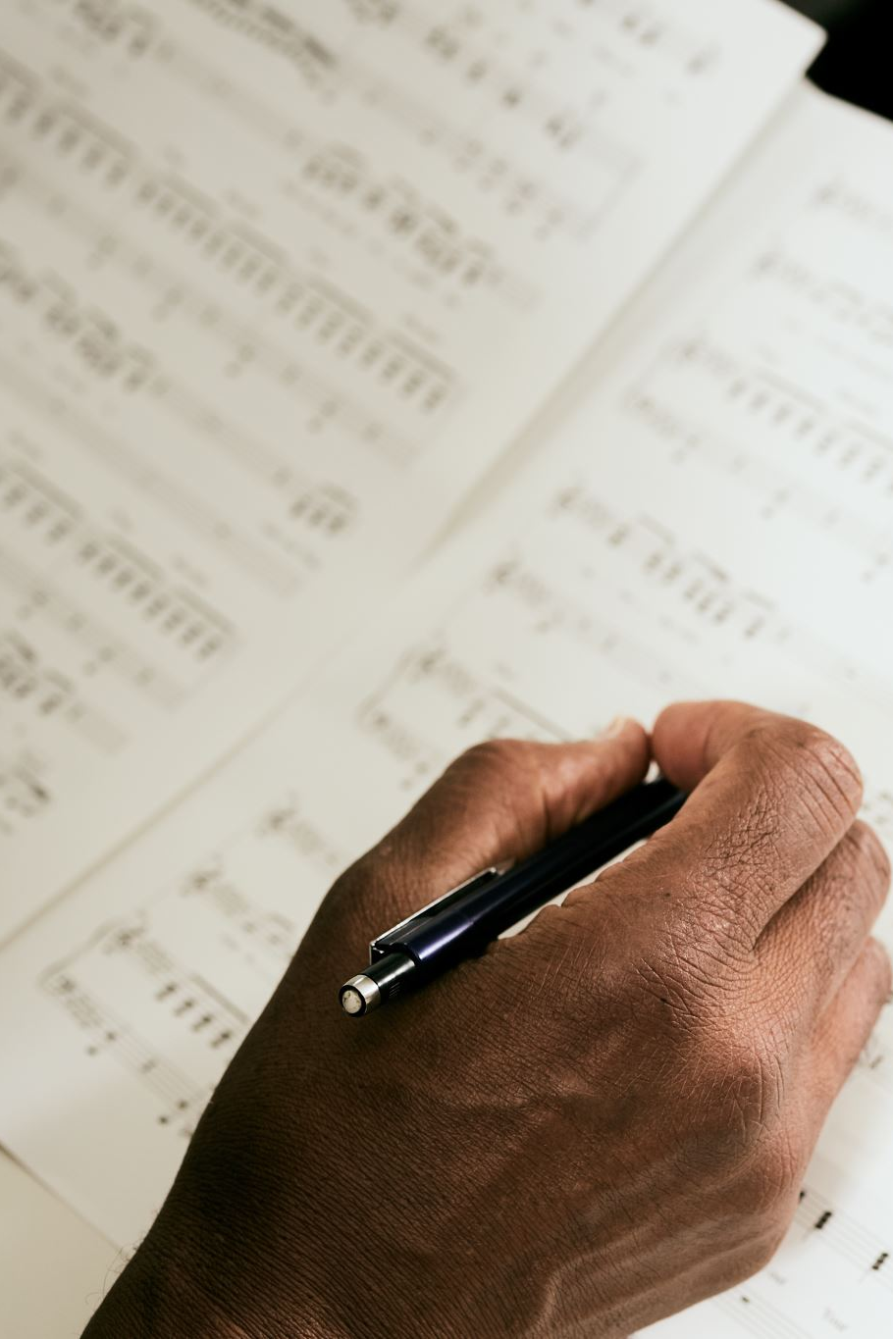
Declaration Rules
Content: Explanation of the rules related to declarations in the grammar
Include declaration_list, declaration, enum_declaration, struct_declaration, var_declaration, and fun_declaration rules

Slide 12

Struct Declaration Rules
Content: Explanation of the rules specific to struct declarations
Include struct_declaration and struct_member rules

Slide 13
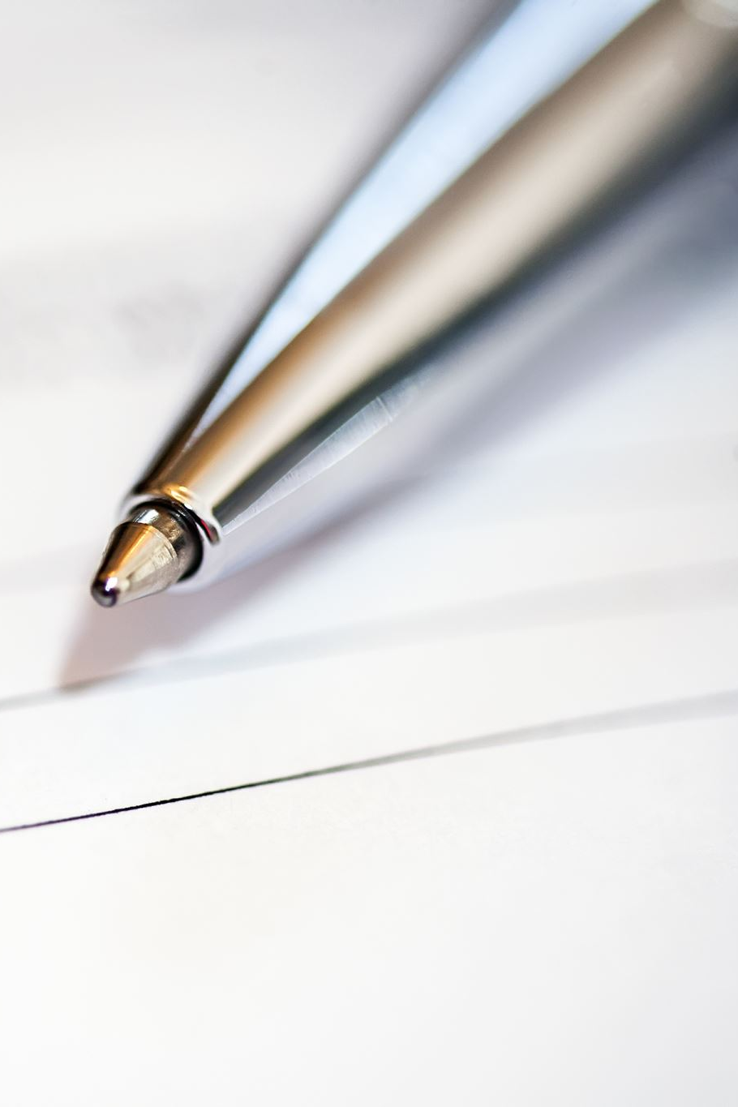
Array Declaration Rules
Content: Explanation of the rules for array declarations
Include array_declaration, parse_array_dimensions, and parse_array_initialization rules

Slide 14
Enum Declaration Rules
Content: Explanation of the rules for enum declarations
Include enum_declaration and enum_item rules

Slide 15

Statement and Expression Rules
Content: Explanation of the rules related to statements and expressions in the grammar
Include statement, if_statement, while_statement, for_statement, return_statement, and expression rules

Slide 16

Parsing Process Overview
Overview of the parsing process, including tokenization and parsing steps

Slide 17

Implementation Details

Slide 18

Implementation Details
Content
Parsing Algorithm
Top-down Parsing, specifically Recursive Descent, is a parsing technique commonly used in compiler construction to parse the syntax of a programming language
Recursive Descent Parsing Process
The parsing process starts from the top-level function, usually named parse , which initiates the parsing of the entire program
The parse function typically calls other functions representing different syntactic constructs of the language, such as program , statement_list , and statement
The program function parses the structure of the program, which may consist of a sequence of statements
The statement_list function parses a list of statements within the program
The statement function parses individual statements based on their type

Slide 19

Implementation Details
Content
Specific Parsing Functions
Specific parsing functions are defined for different types of statements, such as while_statement , for_statement , and return_statement
Modular Parsing Logic
Each parsing function is responsible for recognizing and processing the syntactic elements corresponding to its statement type
By organizing parsing logic into separate functions, Recursive Descent parsing enables modular and readable code, making it easier to understand and maintain

Slide 20

General Overview
Content
Introduction
The provided code implements a parser for a programming language using the top-down parsing approach known as recursive descent
The parser is designed to analyze the syntax of the input code and build a corresponding syntax tree
Main Components
Functions for parsing expressions, statements, and control flow constructs such as while loops, do-while loops, for loops, and return statements
Functions for handling function calls, variable declarations, unary expressions, and more
Structured Approach
The code follows a structured approach, with each function responsible for parsing a specific grammar rule or syntactic construct

Slide 21
General Overview
Content
For example, the "expression" function handles the parsing of general expressions, while the "statement" function parses various types of statements such as if statements, while loops, and return statements
Token Handling
The parser is designed to handle different types of tokens, including identifiers, numbers, arithmetic operators, unary operators, parentheses, and semicolons
Error Handling
Error handling mechanisms are incorporated throughout the code to detect syntax errors and provide informative error messages
Conclusion
Overall, the parser serves as a fundamental component of a compiler or interpreter for the target programming language, enabling the analysis and interpretation of source code written in that language

